Slide 1
L’esercizio fisico nel trattamento multimodale dell’obesità
Dr. Francesca battista
University of Padova, Italy

Slide 2
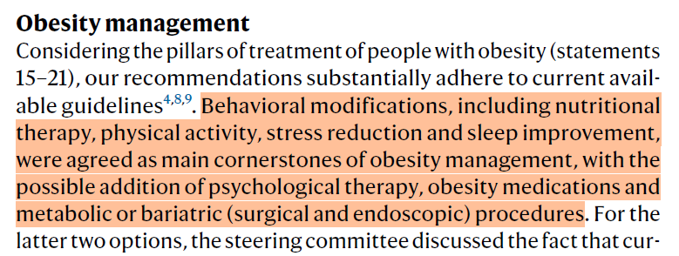
Theme | N. | Statement | Consensus (%)
Therapeutic targets | 22 | Consider that the management and treatment of obesity have wider objectives than weight loss alone and include the prevention, resolution or improvement of obesity-related complications, better quality of life and mental wellbeing, and improvement of physical/social functioning and fitness | 100%
 | 25 | Emphasize long-term, realistic, sustained weight loss to achieve a reduction in health risks and include promotion of weight maintenance and prevention of weight regain. Because obesity is a chronic disease, help persons with obesity understand that lifelong efforts are required to maintain a healthier body weight. | 96%

Slide 3
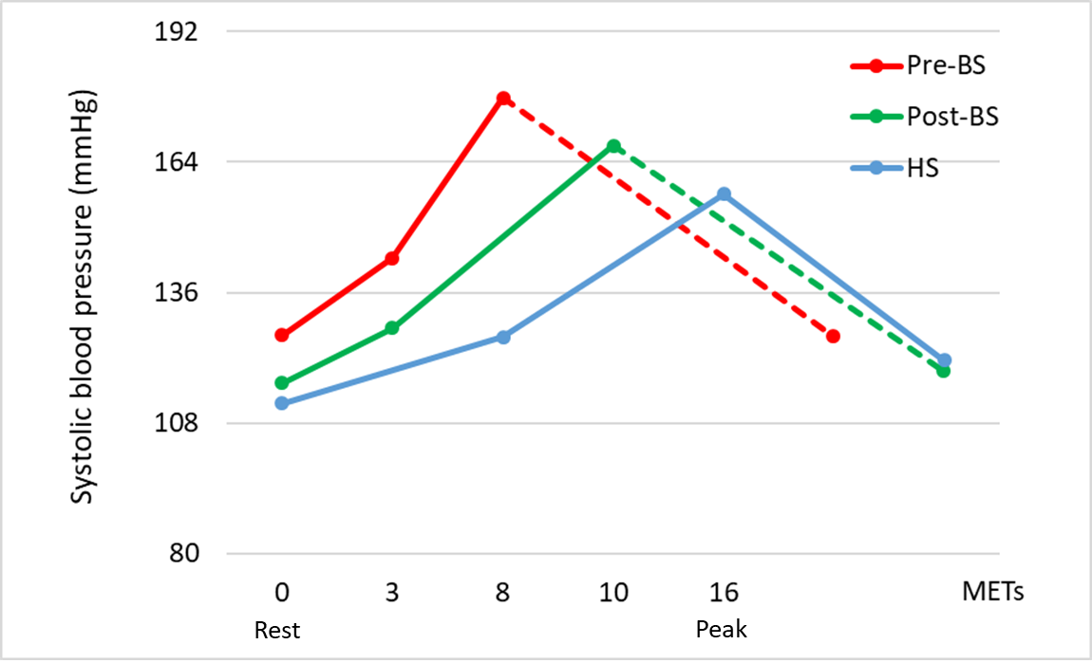
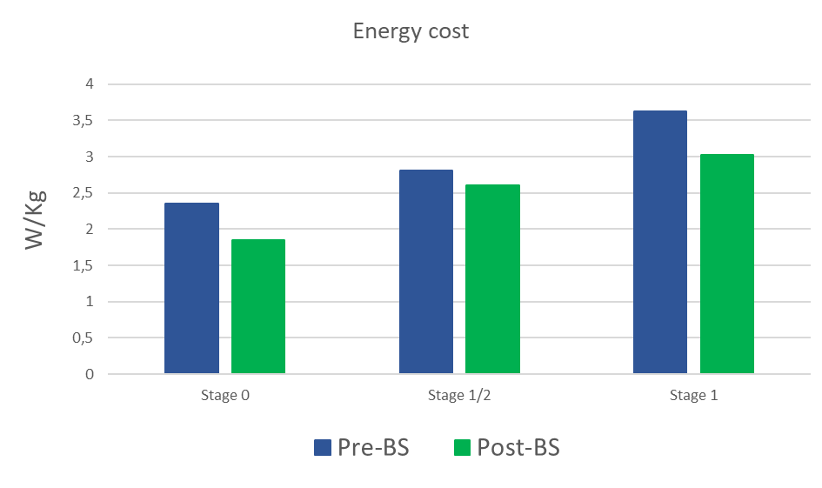
Functional benefit of bariatric surgery
Ventilatory function
Exercise blood pressure
Energetic cost of walk
Borasio, N; […] Battista et al. Obesity Surgery 2021
Battista, F, et al. Green visual poster @ECO2024
Vecchiato M, […] Battista F et al.; Biology 2023

Slide 4
Functional effects of bariatric surgery
And what about exercise?
Absolute VO₂ (ml/min)
Weight related VO₂ (ml/min/Kg)
Level of physical activity
Neunhaeuserer D, […] Ermolao A; Internal and Emergency Medicine; 2020

Slide 5
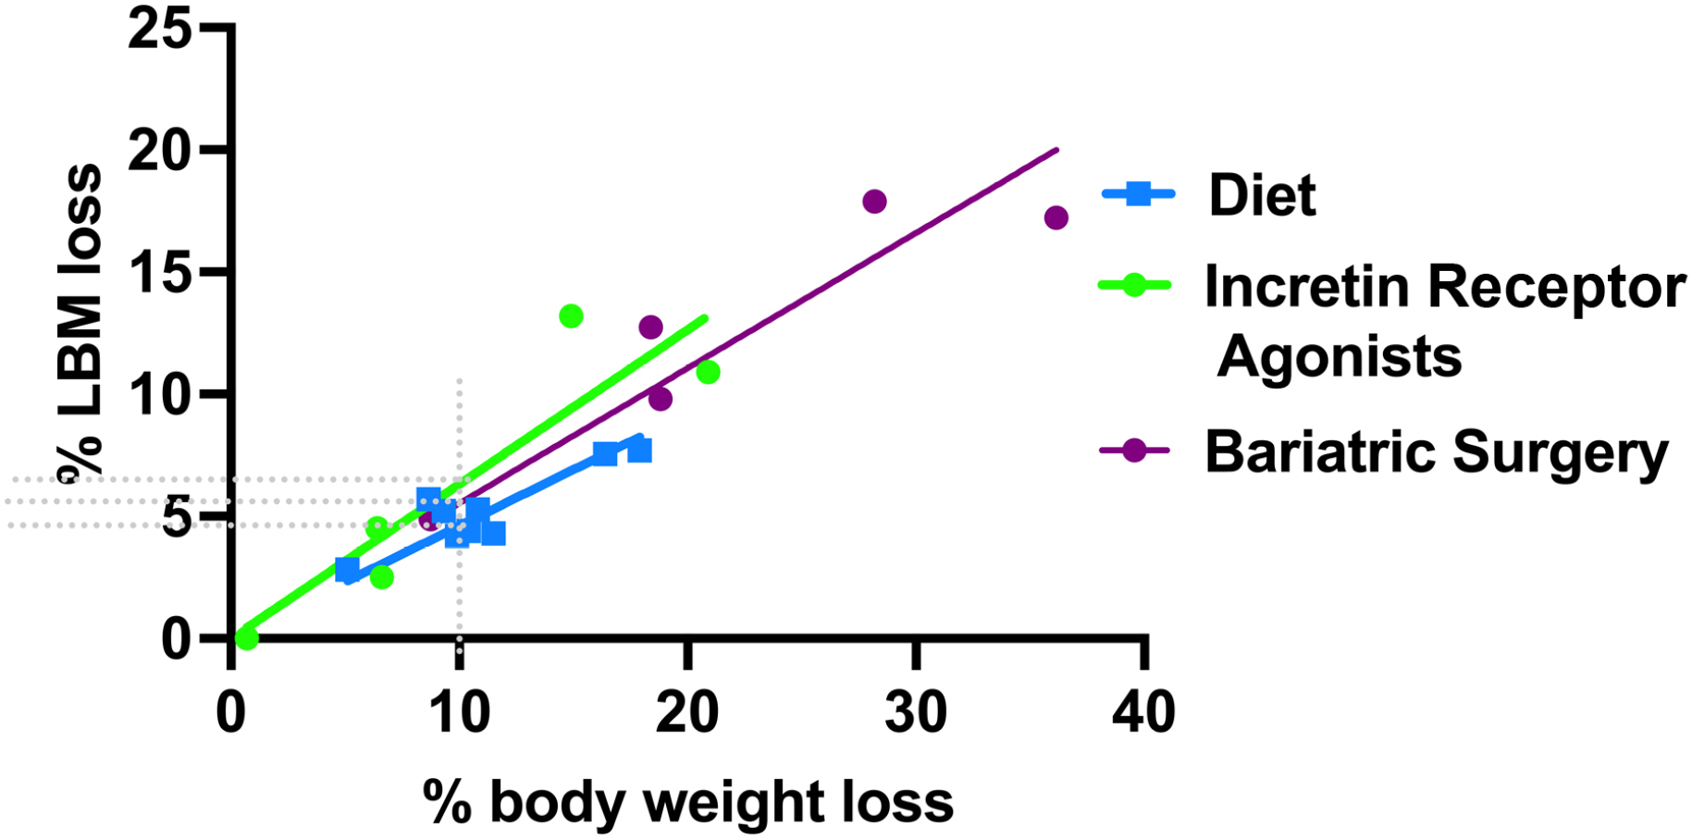
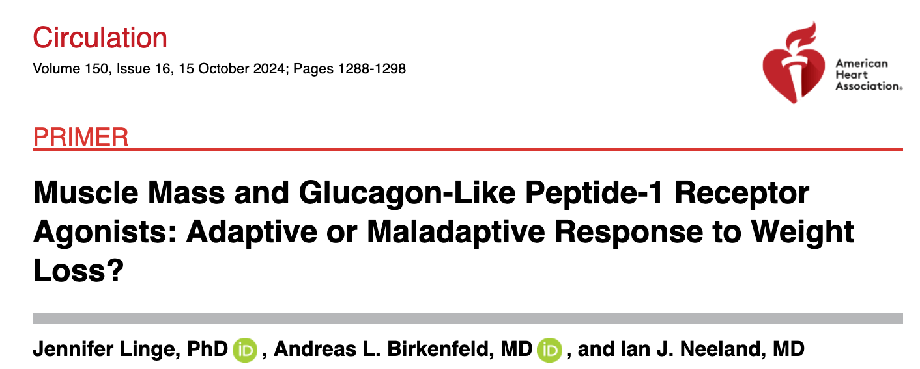
Sarcopenia after weight loss
% weight loss/% lean body mass loss resulting from diet; GLP-1 RA or GLP-1/GIP RA or bariatric surgery (various studies: Magkos et al, Villareal et al, Ravussin et al, Carey et al and Yoshino et al. ).

Slide 6
PHYSICAL ACTIVITY:
Any bodily movement produced by skeletal muscles that results in energy expenditure.
PHYSICAL EXERCISE: Subcategory of physical activity that is planned, structured, repeated with a given purpose: to maintain or increase physical fitness.

Slide 8
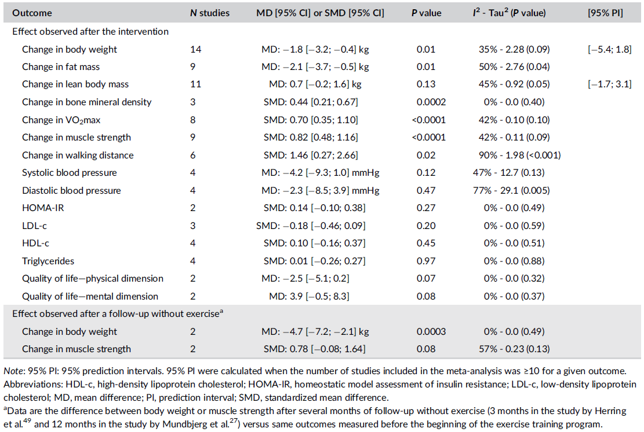
Effect of Exercise in obesity: bariatric surgery
POSTOPERATIVE INTERVENTION
Bellicha et al., Obesity Reviews. 2021.

Slide 10
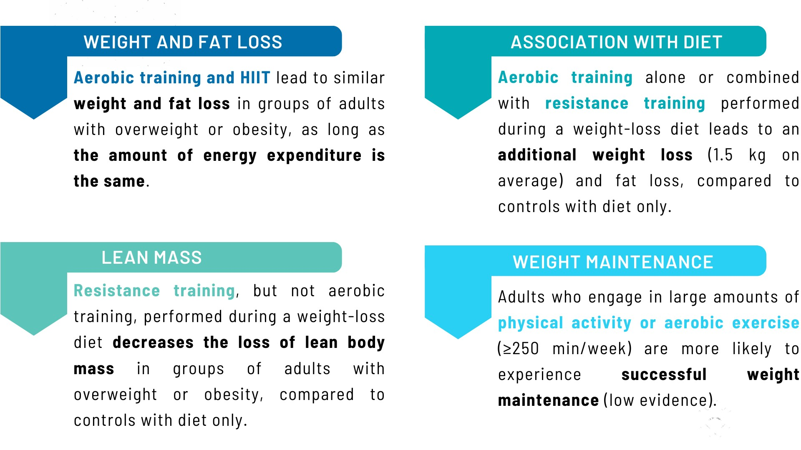
Effect on body composition and weight management
Bellicha et al., Obesity Reviews.

Slide 11
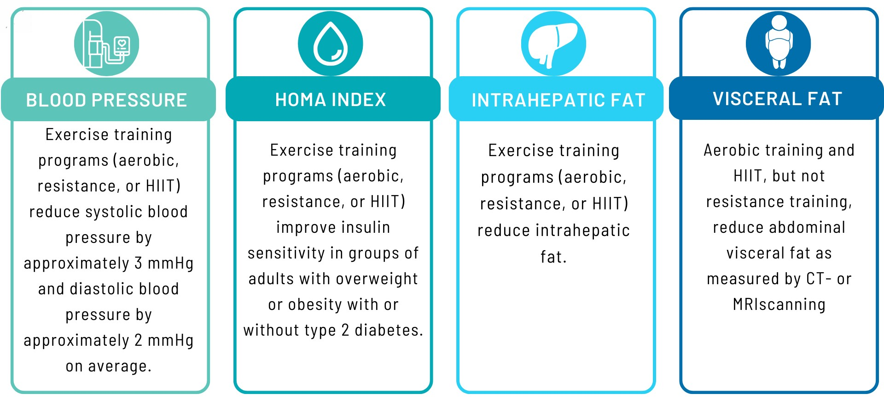
Effect on physical fitness: cardiorespiratory fitness & strength
Battista et al., Obesity Reviews; 2021.

Slide 12
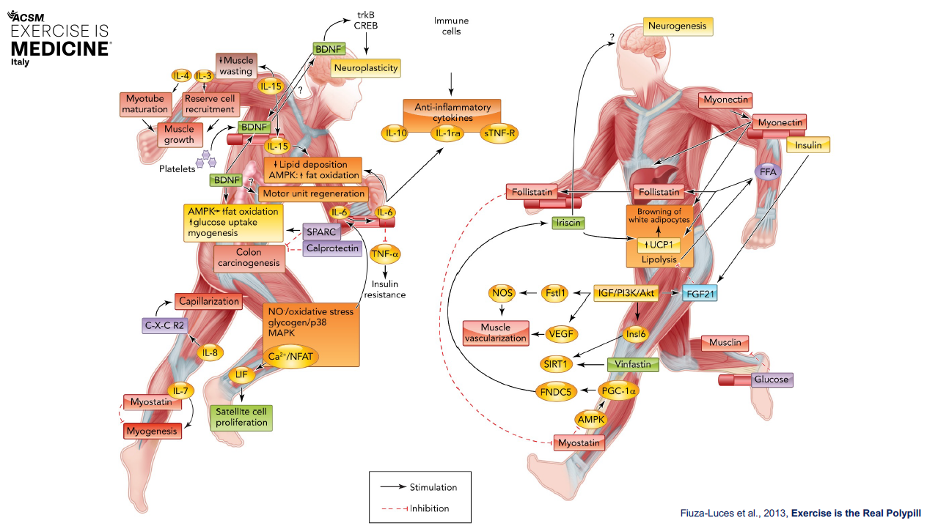
Exercise has more effects than just burning calories.
Cardiorespiratory fitness
Ventilatory limitations
Weight management
Body composition
Visceral fat
Intrahepatic fat
Muscle mass, quality & function
Insulin resistance
Lipid pr ofile
Exercise Pill
Blood pressure control
QoL
Mental health
Eating behaviour
Quality of life

Slide 14
Grazie

